Slide 1

Map Reduce

Slide 2
Before MapReduce…
Large scale data processing was difficult!
Managing hundreds or thousands of processors
Managing parallelization and distribution
I/O Scheduling
Status and monitoring
Fault/crash tolerance
MapReduce provides all of these, easily!

Slide 3
MapReduce Overview
MapReduce is a programming model for processing large data sets with a parallel, distributed algorithm on a cluster
How does it solve our previously mentioned problems?
MapReduce is highly scalable and can be used across many computers.
Many small machines can be used to process jobs that normally could not be processed by a large machine.

Slide 4
How MapReduce works?
MapReduce is a method for distributing a task across multiple nodes
Each node processes data stored on that node
Where possible
Consists of two phases:
Map
Reduce

Slide 5
Features of MapReduce
Automatic parallelization and distribution
Fault‐tolerance
Status and monitoring tools
A clean abstraction for programmers
MapReduce programs are usually written in Java
Can be written in any language using Hadoop Streaming (see later)
All of Hadoop is written in Java
MapReduce abstracts all the ‘housekeeping’ away from the developer
Developer can concentrate simply on working the Map and Reduce functions

Slide 6
The JobTracker/Resource manager
MapReduce jobs are controlled by a software daemon known as the Job Tracker
JobTracker is known as Resource Manager as well as Taks Tracker is known as Node Manager post versions (Hadoop ver: 2.0)
The ApplicationMaster needs to send a heartbeat to the ResourceManager at regular intervals (Default 3 Secs)
The JobTracker resides on a ‘master node’
Clients submit MapReduce jobs to the JobTracker
The JobTracker assigns Map and Reduce tasks to other nodes on the cluster
These nodes each run a software daemon known as the TaskTracker
The TaskTracker is responsible for actually instantiating the Map or Reduce task, and reporting progress back to the JobTracker.

Slide 7
Basic Cluster Configuration

Slide 8
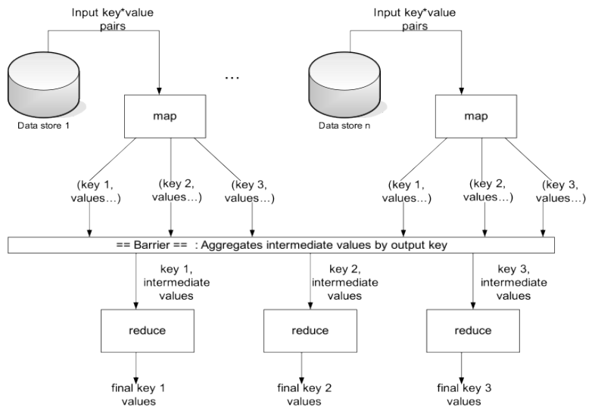
MR Diagram

Slide 9
MapReduce: Terminology

Slide 10
MapReduce : The Mapper

Slide 11
MapReduce : The Mapper

Slide 12
MapReduce : The Reducer

Slide 13
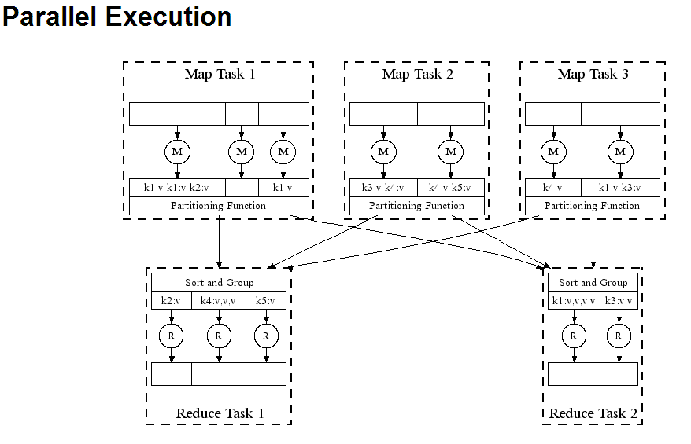
Diagram

Slide 14
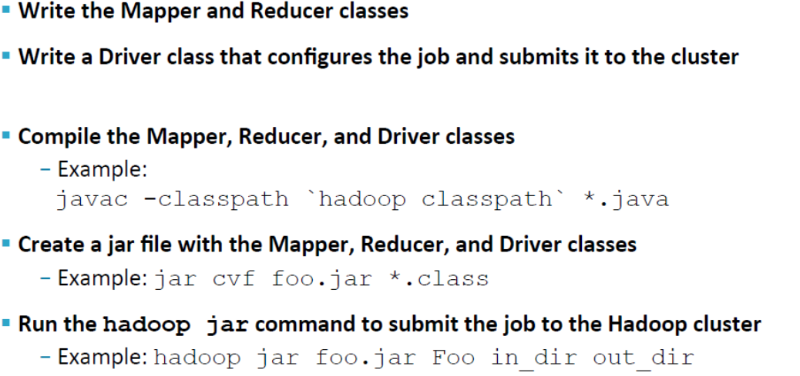
Creating and Running a MapReduce Job

Slide 15
The MapReduce Flow: The Mapper

Slide 16
The MapReduce Flow: Shuffle and Sort

Slide 17
The MapReduce Flow: The Reducer

Slide 18
Our MapReduce Program: WordCount
This consists of three portions
The driver Code – Code that runs on the client to configure and submit the job
The Mapper
The Reducer

Slide 19
Some Standard Input Formats

Slide 20
Keys and Values
Keys and Values Are Objects
Values are objects that implements Writable
Keys are objects that implements WritableComparable
Hadoop defines its own ‘box classes’ for strings, integers etc
IntWritable
LongWritables
FloatWritables
Text
…

Slide 21
Driver Code
import org.apache.hadoop.fs.Path;
import org.apache.hadoop.io.IntWritable;
import org.apache.hadoop.io.Text;
import org.apache.hadoop.mapreduce.lib.input.FileInputFormat;
import org.apache.hadoop.mapreduce.lib.output.FileOutputFormat;
import org.apache.hadoop.mapreduce.Job;
public class WordCount {
public static void main(String[] args) throws Exception {
if (args.length != 2) {
System.out.printf("Usage: WordCount <input dir> <output dir>\n");
System.exit(-1);
}
Job job = new Job();
job.setJarByClass(WordCount.class);
job.setJobName("Word Count");
FileInputFormat.setInputPaths(job, new Path(args[0]));
FileOutputFormat.setOutputPath(job, new Path(args[1]));
job.setMapperClass(WordMapper.class);
job.setReducerClass(SumReducer.class);
job.setMapOutputKeyClass(Text.class);
job.setMapOutputValueClass(IntWritable.class);
job.setOutputKeyClass(Text.class);
job.setOutputValueClass(IntWritable.class);
boolean success = job.waitForCompletion(true);
System.exit(success ? 0 : 1);
} }

Slide 22
Mapper Code
import java.io.IOException;
import org.apache.hadoop.io.IntWritable;
import org.apache.hadoop.io.LongWritable;
import org.apache.hadoop.io.Text;
import org.apache.hadoop.mapreduce.Mapper;
public class WordMapper extends Mapper<LongWritable, Text, Text, IntWritable> {
@Override
public void map(LongWritable key, Text value, Context context) throws IOException, InterruptedException {
String line = value.toString();
for (String word : line.split("\\W+")) {
if (word.length() > 0) {
context.write(new Text(word), new IntWritable(1));
}
}
}
}

Slide 23
Reducer Code
import java.io.IOException;
import org.apache.hadoop.io.IntWritable;
import org.apache.hadoop.io.Text;
import org.apache.hadoop.mapreduce.Reducer;
public class SumReducer extends Reducer<Text, IntWritable, Text, IntWritable> {
@Override
public void reduce(Text key, Iterable<IntWritable> values, Context context) throws IOException, InterruptedException {
int wordCount = 0;
for (IntWritable value : values) {
wordCount += value.get();
}
context.write(key, new IntWritable(wordCount));
}
}

Slide 24
Hands-on to execute a MapReduce Job - WordCount

Slide 25
Mean
We want to find the mean max temperature for every month
Input Data:
Temperature in Milan
(DDMMYYY, MIN, MAX)
01012000, -4.0, 5.0
02012000, -5.0, 5.1
03012000, -5.0, 7.7
…
29122013, 3.0, 9.0
30122013, 0.0, 9.8
31122013, 0.0, 9.0

Slide 26
Mean
Sample input data:
01012000, 0.0, 10.0
02012000, 0.0, 20.0
03012000, 0.0, 2.0
04012000, 0.0, 4.0
05012000, 0.0, 3.0
Mapper #1: lines 1, 2
Mapper #2: lines 3, 4, 5
Mapper#1: mean = (10.0 + 20.0) / 2 = 15.0
Mapper#2: mean = (2.0 + 4.0 + 3.0) / 3 = 3.0
Reducer mean = (15.0 + 3.0) / 2 = 9.0
But the correct mean is:
(10.0 + 20.0 + 2.0 + 4.0 + 3.0) / 5 = 7.8

Slide 27
Hands-on to executing a Map Reduce Job - Mean

Slide 28
Sorting & Searching

Slide 29
Sorting
MapReduce is very well suited to sorting large data sets
Recall: keys are passed to the Reducer in sorted order
Assuming the file to be sorted contains lines with a single value:
Mapper is merely the identity function for the value
(k, v) -> (v, _)
Reducer is the identity function
(k, _) -> (k, '')

Slide 30
Searching
Assume the input is a set of files containing lines of text
Assume the Mapper has been passed the pattern for which to search as a special parameter
We saw how to pass parameters to your Mapper
Algorithm:
Mapper compares the line against the pattern
If the pattern matches, Mapper outputs (line, _)
Or (filename+line, _), or …
If the pattern does not match, Mapper outputs nothing
Reducer is the Identity Reducer
Just outputs each intermediate key

Slide 31
Streaming API

Slide 32
The Streaming API: Motivation
The Streaming API allows developers to use any language they wish to write Mappers and Reducers
As long as the language can read from standard input and write to standard output
Advantages of the Streaming API:
No need for non‐Java coders to learn Java
Fast development time
Ability to use existing code Libraries
Disadvantages of the Streaming API:
Performance
Primarily suited for handling data that can be represented as text
Streaming jobs can use excessive amounts of RAM or fork excessive numbers of processes
Although Mappers and Reducers can be written using the Streaming API, Partitioners, InputFormats etc. must still be written in Java

Slide 33
How Streaming Works
To implement streaming, write separate Mapper and Reducer programs in the language of your choice
They will receive input via stdin
They should write their output to stdout
If TextInputFormat (the default) is used, the streaming Mapper just receives each line from the file on stdin
No key is passed
Streaming Mapper and streaming Reducer’s output should be sent to stdout as key (tab) value (newline)
Separators other than tab can be specified

Slide 34
Map Reduce With Python Program
Implementing Hadoop MR Streaming API into python coding
Declaring Mapper and Reducer python program to the corresponding Hadoop Input and Output file formats
:~$ hadoop jar /home/smartr/hadoop-2.7.1/share/hadoop/tools/lib/hadoop-streaming-2.7.1.jar -mapper /home/smartr/Map_Reduce/python/mapper.py -reducer /home/smartr/Map_Reduce/python/reducer.py -input /InputDirl/data_10.txt -output /python/result2/

Slide 35
Joins

Slide 36

Joins
When processing large data sets the need for joining data by a common key can be very useful, if not essential.
We will be covering 2 types of joins, Reduce-Side joins, Map-Side joins
SELECT Employees.Name, Employees.Age, Department.Name FROM Employees INNER JOIN Department ON Employees.Dept_Id=Department.Dept_Id

Slide 37
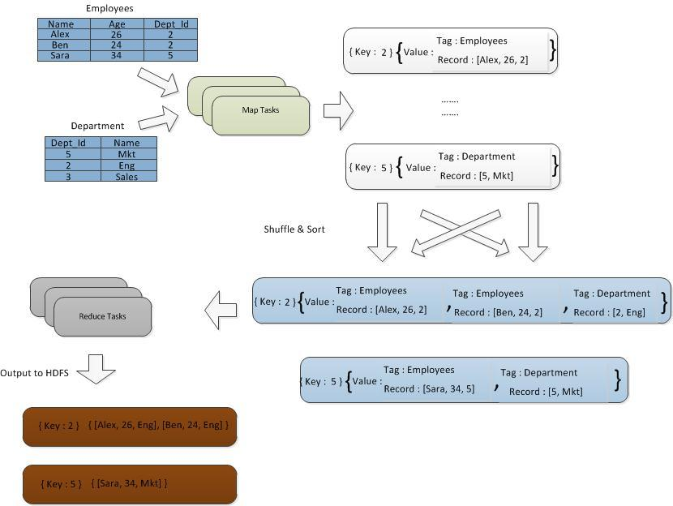
Reduce Side Join

Slide 38
Sample Code
map (K table, V rec) {
dept_id = rec.Dept_Id
tagged_rec.tag = table
tagged_rec.rec = rec
emit(dept_id, tagged_rec)
}
reduce (K dept_id, list<tagged_rec> tagged_recs) {
for (tagged_rec : tagged_recs) {
for (tagged_rec1 : taagged_recs) {
if (tagged_rec.tag != tagged_rec1.tag) {
joined_rec = join(tagged_rec, tagged_rec1)
}
emit (tagged_rec.rec.Dept_Id, joined_rec)
}
}

Slide 39
Thank You

